Slide 1
CSC 362: System Programming
Lecture 17
Original slides by: Amitabha Dey
Adapted by: Dr. Richard Johnson
Department of Computer Science University of North Carolina at Greensboro

Slide 2

Status Check
Implicit Free List, Bidirectional Coalescing, Explicit Free List
Splitting, False Fragmentation, Boundary Tags
Free Block Insertion Policy - LIFO
What we will cover today
Threads vs Processes
Multi-threaded Programs in C
pthread_create
pthread_join
pthread_exit
pthread_cancel

Slide 3
Processes vs. Threads

Slide 4
Why Processes are not Ideal?
Processes are not very efficient
Each process has its own PCB and OS resources
Typically, high overhead for each process: e.g., 1.7 KB per task_struct on Linux!
Creating a new process is often very expensive
Processes don't (directly) share memory
Each process has its own address space
Parallel and concurrent programs often want to directly manipulate the same memory (e.g.When processing elements of a large array in parallel)
Note: Many OS's provide some form of inter-process shared memory
cf., UNIX shmget() and shmat() system calls
Still, this requires more programmer work and does not address the efficiency issues.
Notes:
Why processes are not ideal?:
Processes have high overhead (e.g., 1.7 KB task_struct on Linux),
are expensive to create,
and do not directly share memory.

Slide 5
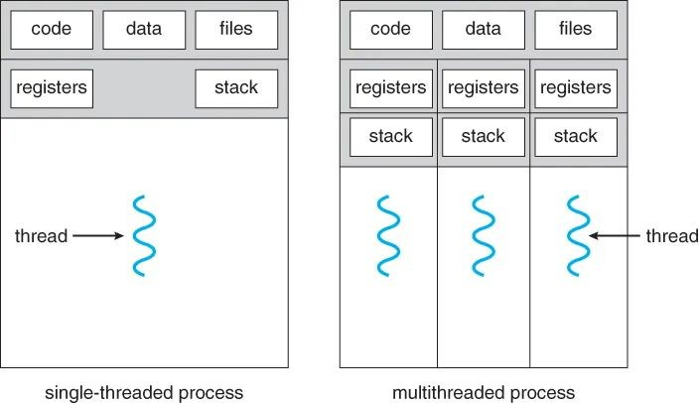
The thread is now the unit of “CPU Scheduling” A process is just a container for threads
Multi-threaded Programming
Thread vs Process
A thread is the smallest unit of execution within a process, allowing multiple tasks to be carried out concurrently within a single process. Threads are a part of a process.
A process can contain one or more threads that share the same memory space but have their own individual execution stacks and registers.
Each thread has its own stack, CPU Registers, etc.
All threads within a process share the same address space and OS resources
Threads share memory! So, they can communicate
Image credit - A X I X A @ Medium.com
Notes:
Thread vs. Process (Definition):
A thread is the smallest unit of execution within a process;
multiple threads can run concurrently within one process,
sharing memory but maintaining individual stacks.
Shared Resources:
Threads within a process share the same address space and OS resources (code, data, files)
but have individual execution stacks and registers.
Architectural Comparison:
In multithreading,
the thread becomes the unit of CPU scheduling,
while the process acts as a container for resources.

Slide 6
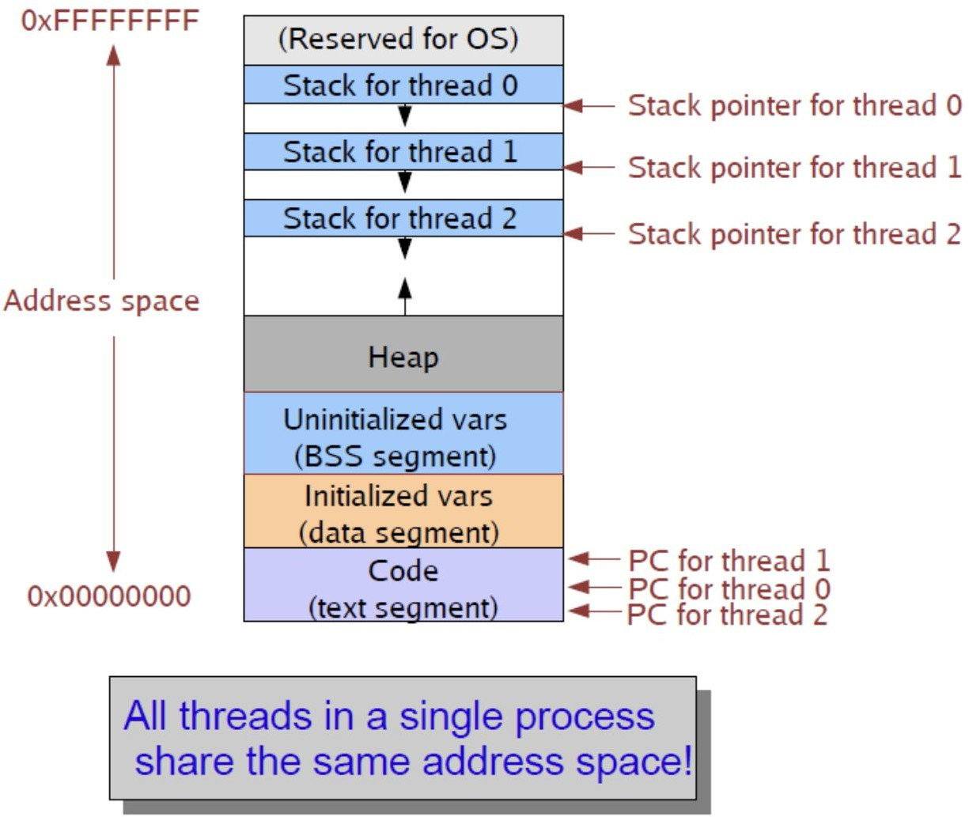
Multi-threaded Programming
Thread vs Process
A thread is the smallest unit of execution within a process, allowing multiple tasks to be carried out concurrently within a single process. Threads are a part of a process.
A process can contain one or more threads that share the same memory space but have their own individual execution stacks and registers.
Each thread has its own stack, CPU Registers, etc.
All threads within a process share the same address space and OS resources
Threads share memory! So, they can communicate
Image credit - Rutgers University
Notes:
Figure:
A memory address space diagram showing how multiple threads
share a single process's code, data, and heap segments
while having independent stacks and program counters.

Slide 7
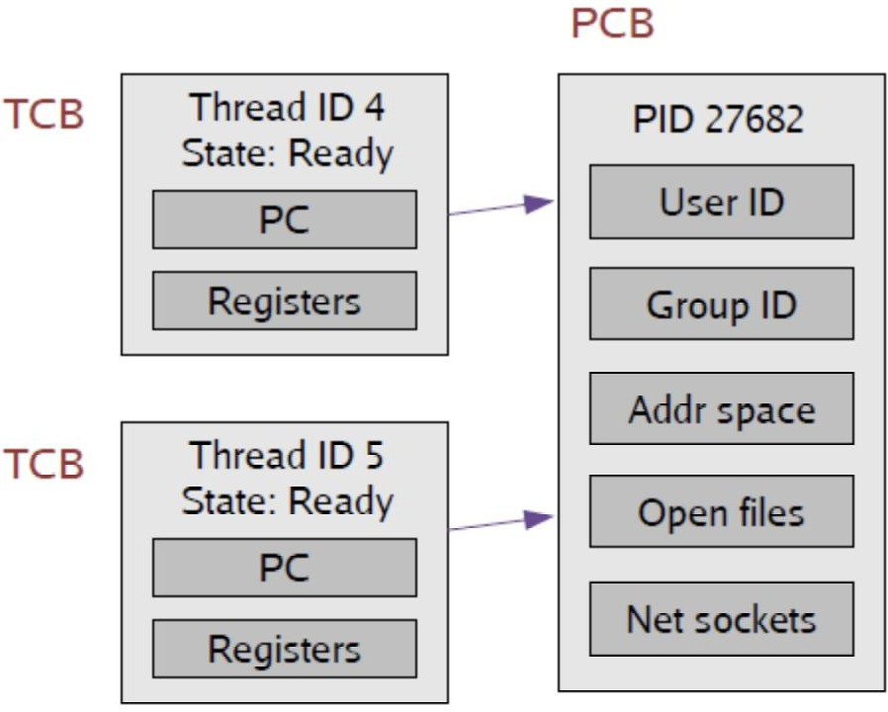
Multi-threaded Programming
Thread vs Process
Idea: Break the PCB into two pieces:
Thread Specific Stuff: CPU State
Process Specific Stuff: Address Space and OS resources
TCBs are smaller and cheaper ! TCB: 24 fields
PCB: 106 fields
Image credit - Rutgers University
Notes:
Control Block Comparison:
Comparison of Thread Control Blocks (TCBs) and Process Control Blocks (PCBs);
TCBs are "smaller and cheaper" with fewer fields (24 vs. 106 in some systems).
Figure:
A diagram illustrating the relationship between Thread Control Blocks (TCB) and a Process Control Block (PCB).
Each TCB contains a unique ID, state, program counter, and registers,
while the PCB holds shared resources like address space and open files.

Slide 8
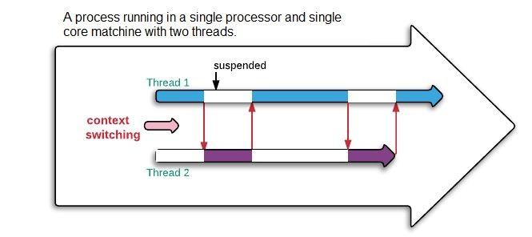
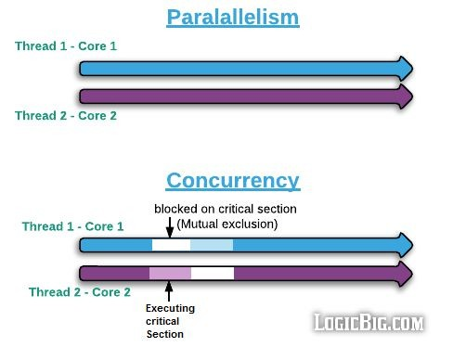
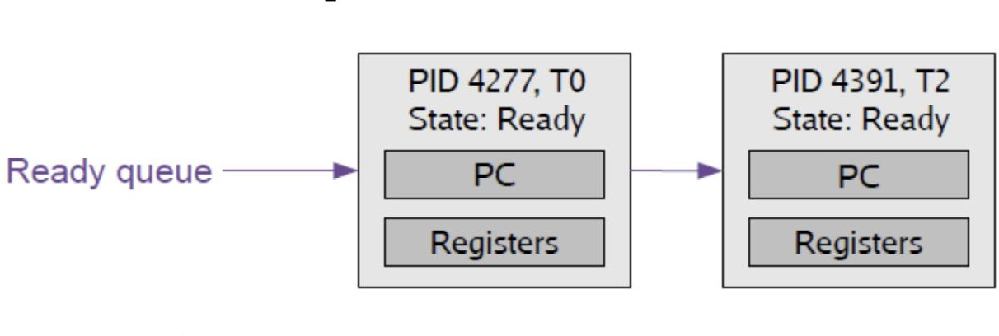
Multi-threaded Programming
Thread vs Process
Context switch between two threads of same process
Need not change the address space
Context switch between two threads of different process
Need to change the address space.
Image credit - Rutgers University
Image credit - https://www.logicbig.com/
Notes:
Context Switching:
Switching between threads of the same process is faster because the address space (page tables, etc.) does not need to be swapped.
Parallelism vs. Concurrency:
Visualizes how threads can run truly in parallel on different cores or concurrently via time-slicing on a single core.

Slide 9
Multi-threaded Programming
Differences
Resource Sharing: Threads within the same process share the same memory space and resources, while processes have separate memory spaces and resources.
Fault Isolation: If one thread in a process encounters an error, it can potentially affect other threads within the same process. However, if one process encounters an error, it typically does not affect other processes because they are isolated from each other.
Context Switching: Switching between threads within the same process is typically faster than switching between processes. This is because threads share the same memory space, so less overhead is required to switch between them.
Thread vs Process - Similarities vs Differences
Similarities
Execution: Both threads and processes involve the execution of instructions. They represent sequences of instructions that the CPU executes.
Resource Allocation: Both threads and processes require system resources such as memory, CPU time, and I/O devices to execute.
Control Flow: Threads and processes both have their own control flow. They execute instructions sequentially, following the program's logic.
Notes:
Similarities vs. Differences:
Both involve instruction execution and resource allocation,
but threads share memory (risking less fault isolation) and switch faster than processes.

Slide 10
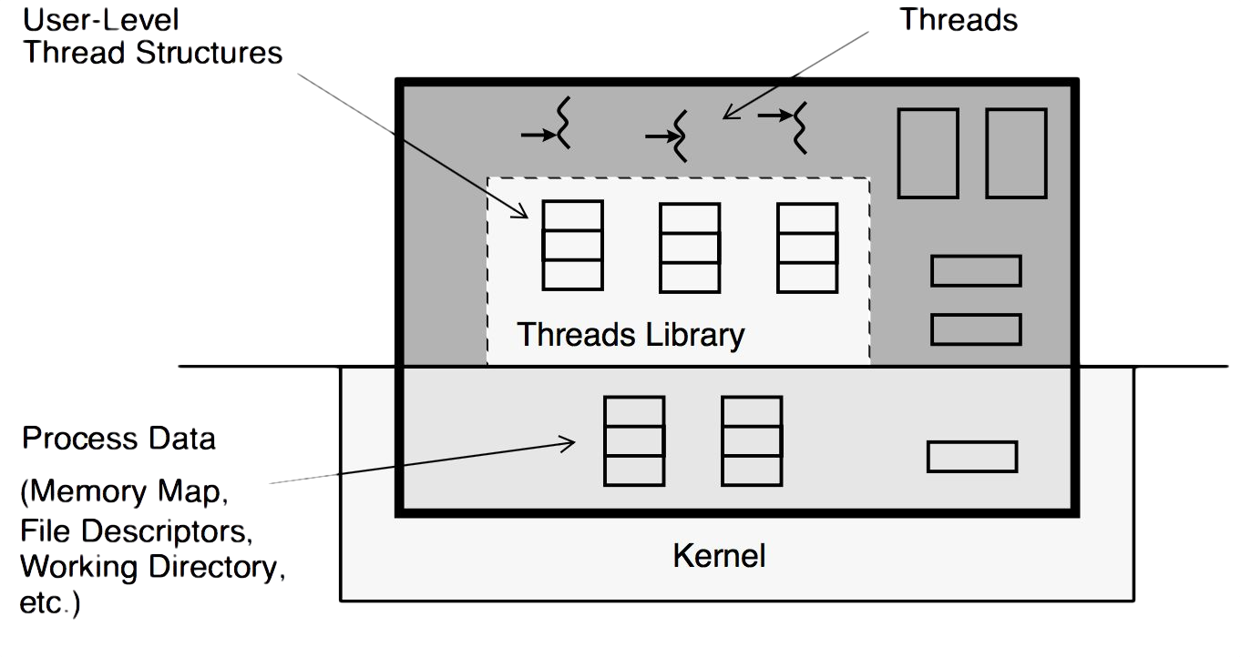
Multi-threaded Programming
The Value of Using Threads
The main benefits of writing multithreaded programs are:
Performance gains from multiprocessing hardware (parallelism)
Increased application throughput
Increased application responsiveness
Replacing process-to-process communications
Efficient use of system resources
Simplified realtime processing
Simplified signal handling
The ability to make use of the inherent concurrency of distributed objects
There is one binary that runs well on both uniprocessors and multiprocessors
The ability to create well-structured programs
There can be a single source for multiple platforms
Image credit - https://comp3511.github.io/
Notes:
Value of Threads:
Benefits include
increased application responsiveness,
simplified signal handling,
and efficient use of multiprocessor hardware.

Slide 11
Pthreads in C

Slide 12
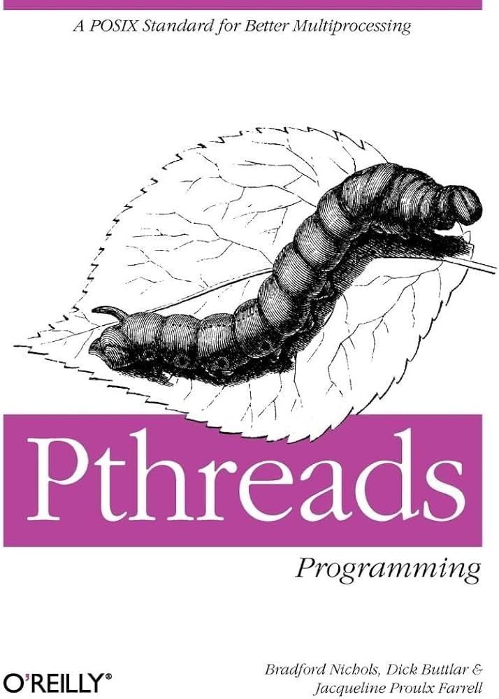
POSIX Thread Libraries
pthread family of functions
POSIX (Portable Operating System Interface) is a family of standards specified by the IEEE for Unix-like systems.
POSIX Threads (pthreads) are the POSIX standard for threading in C, enabling parallelism by allowing multiple threads to run concurrently within a single process.
A thread is a path of execution within a process, it can be considered as a lightweight process (LWP), a process can also contain multiple threads.
The standard library for creating a thread in your program lies in the POSIX layer in the Operating System.
Notes:
POSIX Thread Libraries:
Introduces pthreads as the POSIX standard for C threading,
enabling portable parallelism through a standard API.

Slide 13
POSIX Thread Libraries
Programming Interfaces
Process management functions
fork
creates a new process
wait
waits for child exit and gets status
kill
signals (stops) another process
exit
exits this process
Thread management functions
pthread_create
creates a new thread
pthread_join
waits for thread exit and gets status
pthread_cancel
stops a different thread
pthread_exit
exits this thread
Notes:
Programming Interfaces:
Compares process functions (fork, wait, exit)
to their thread counterparts (pthread_create, pthread_join, pthread_exit).

Slide 14
Multithreading in C
Creating Threads
The first argument in pthread_create() is a variable that holds the address that reference to the thread we create.
The second argument is which typed to
pthread_attr_t is a variable that let us address the
attributes of the thread such as priority.
The third argument we need to supply to this system call is a function pointer that let the kernel knows where the thread should begin from.
The fourth argument is the parameter we would like to pass to the function that we are going call from this thread.
pthread_create()
int pthread_create (
pthread_t *thread,
const pthread_attr_t *attr,
void *(*start_routine) (void *),
void *arg);
Notes:
pthread_create Syntax:
Details the four arguments:
thread ID pointer,
attributes,
start routine (function pointer),
and the argument passed to that function.

Slide 15
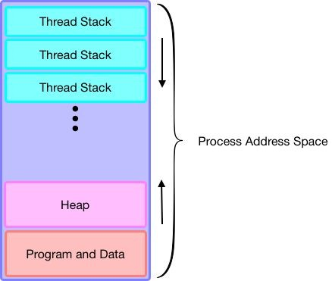
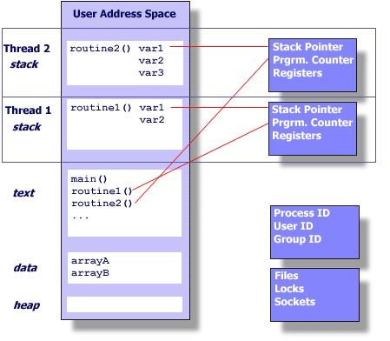
Multithreading in C
Creating Threads
Unlike fork() which
returns an entirely independent copy of the process, a thread shares the address space within the same process.
This feature allows threads to access the same data structures and variables, hence facilitates the communication between threads.
Image credit - https://comp3511.github.io/
Image credit - https://my.eng.utah.edu/
Notes:
Thread Communication:
Unlike fork, threads share address space,
allowing them to communicate easily by manipulating the same data structures.
Memory Layout:
Visualizes how each thread is allocated its own stack within the shared process address space.

Slide 16
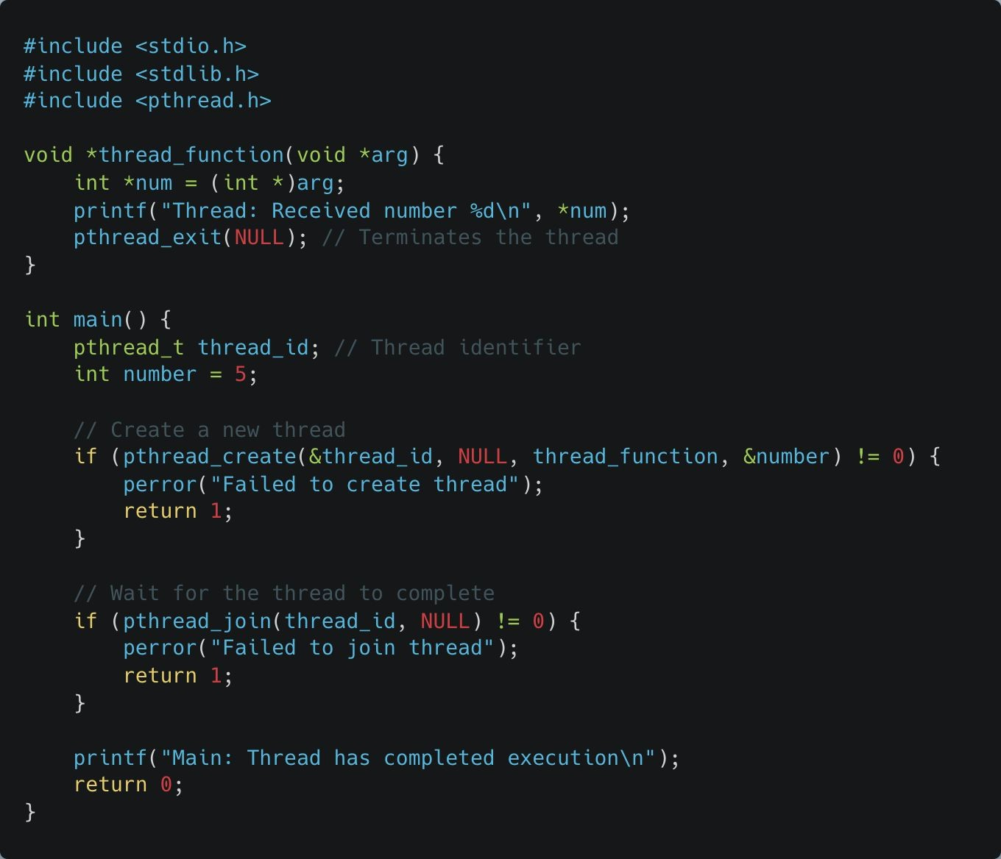
Multithreading in C
Creating Threads
The pthread_create function is used to start a new thread. It requires a pointer to the thread ID, thread attributes (can be NULL for default attributes), a function pointer to the thread routine, and a parameter for the thread function.
Notes:
Creating Threads:
Shows C code using pthread_create and emphasizes that each thread executes independently on its own stack.
See example:
pthread_create.c

Slide 17
Multithreading in C Creating Threads
pthread_create initializes thread_id with a new thread running thread_function. The fourth argument is passed as arg, which thread_function will interpret as an integer.
pthread_exit is used to terminate the thread. The thread could return a value if required.
Key Concept: Each thread has its own stack, allowing it to execute independently within the same process memory space.

Slide 18
Managing Thread Lifecycle

Slide 19
Multithreading in C
Waiting for a Thread to Complete
Like fork(), if we would like to wait for the thread to finish and get back the result, we can use pthread_join().
It suspends the execution of the calling thread until the target thread terminates unless the target thread has already terminated.
At this point, the second argument that is passed to pthread_join() will be set for whatever pointer value that is returned by the target function we were calling when pthread_create()is called.
If the join is successful, it returns zero by default, otherwise an error number will be return.
pthread_join()
int pthread_join (
pthread_t thread,
void **value_ptr
);
Notes:
pthread_join Syntax:
Function used to wait for a specific thread to terminate and optionally retrieve its return value.

Slide 20
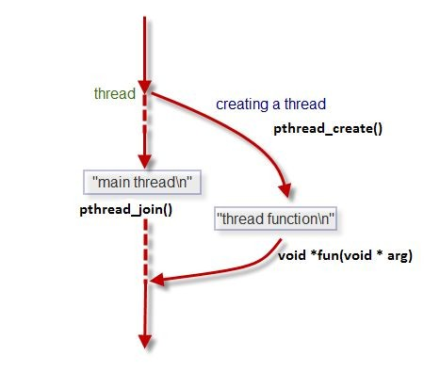
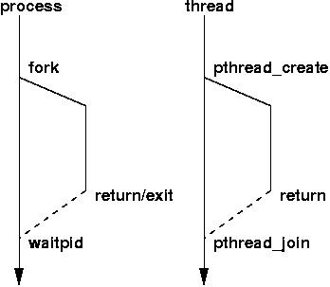
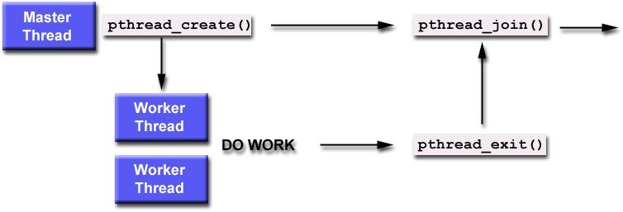
Multithreading in C
Waiting for a Thread to Complete
pthread_join() is used to wait for a specific thread to finish its execution before continuing with the execution of the calling thread.
If you don’t include pthread_join:
The main thread (or any other thread that spawned the thread) may continue execution regardless of whether the other thread has finished. This can lead to potential issues such as Resource Leakage and Unpredictable Behavior
Image credit - https://bestshoperss.top/
Image credit - https://www.cs.fsu.edu/
Image credit - https://hpc-tutorials.llnl.gov/
Notes:
Why Join?:
Failing to join can lead to resource leakage (zombie threads) and unpredictable behavior
if the main thread finishes before its children.

Slide 21
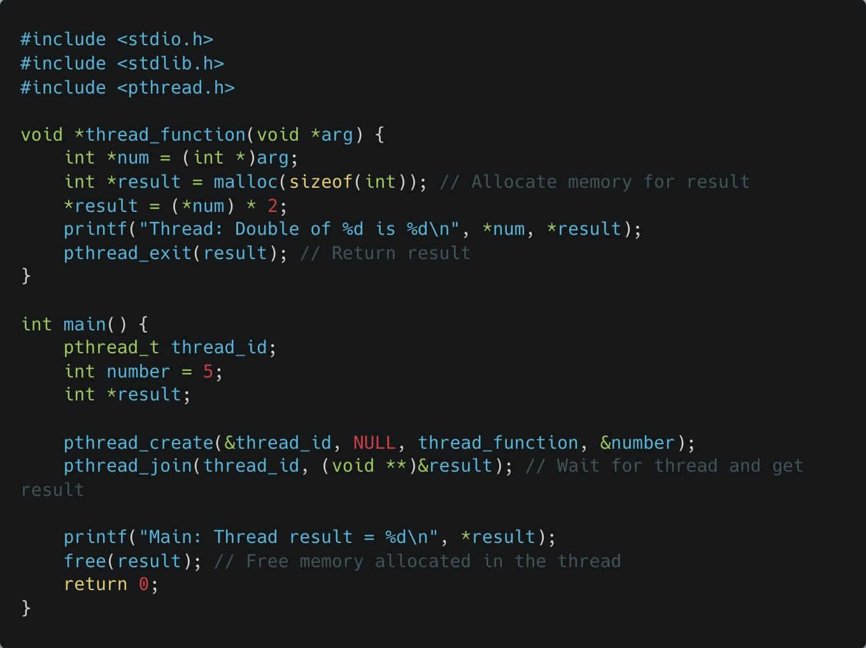
Multithreading in C
Waiting for a Thread to Complete
The pthread_join function allows the main thread (or any other thread) to wait for a specific thread to complete its execution, retrieve the return value, and release resources.
Notes:
Joining Threads:
Demonstrates synchronization where the main thread waits for a child thread and retrieves an exit status.
See example:
pthread_join.c

Slide 22
Multithreading in C
Waiting for a Thread to Complete
pthread_join waits for thread_id to complete, allowing the main thread to retrieve the value returned by pthread_exit.
Memory is allocated inside the thread function and freed in main, showcasing inter-thread communication.
Key Concept: Using pthread_join ensures threads are properly synchronized, avoiding premature termination of the main thread before child threads complete.

Slide 23
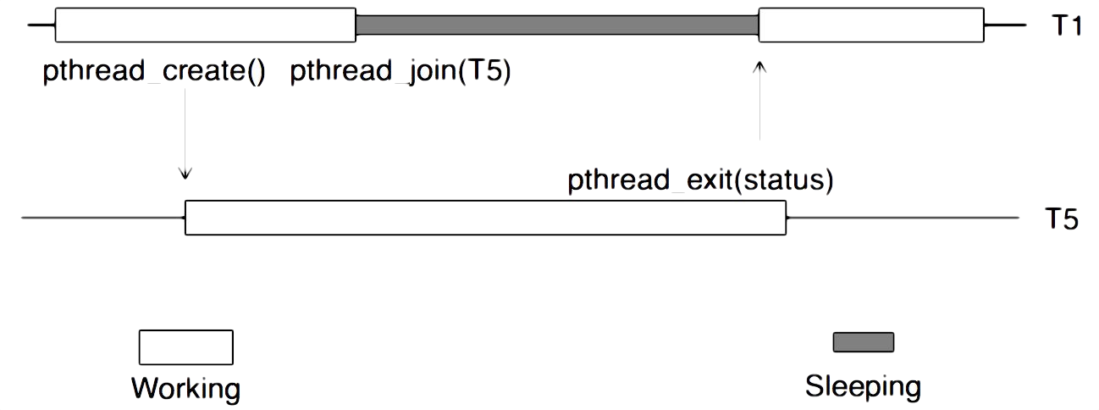
Multithreading in C
Terminating a Thread
Sometimes you specifically want to wait for a thread to exit. Perhaps you’ve created 20 threads to do 20 pieces of a task, and you can’t continue until they are all finished.
One way to do this, is to call the wait (in POSIX, join) function on each of the desired thread IDs.
The caller will block until each of the specified threads has exited. The other way is to use normal synchronization functions.
Image credit - https://comp3511.github.io/
Notes:
Terminating a Thread:
Methods include returning from the start routine, calling pthread_exit, or being canceled by another thread.

Slide 24
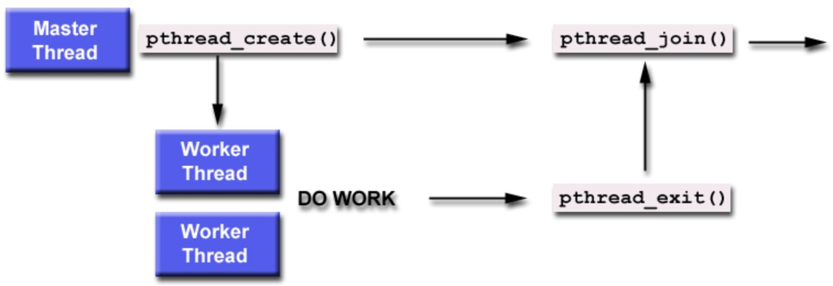
Multithreading in C
Terminating a Thread
The pthread_exit() function terminates the calling thread, making its exit status available to any waiting threads.
Normally, a thread terminates by returning from the start routine that was specified in the pthread_create() call which started it.
An implicit call to pthread_exit()occurs when any thread returns from its start routine. (With the exception of the initial thread, at which time an implicit call to exit() occurs).
The pthread_exit() function provides an interface similar to exit() but on a per-thread basis.
pthread_exit()
void pthread_exit (
void *value_ptr
);
Notes:
pthread_exit Syntax:
Explicitly terminates the calling thread and makes its exit status available to any thread calling pthread_join.

Slide 25
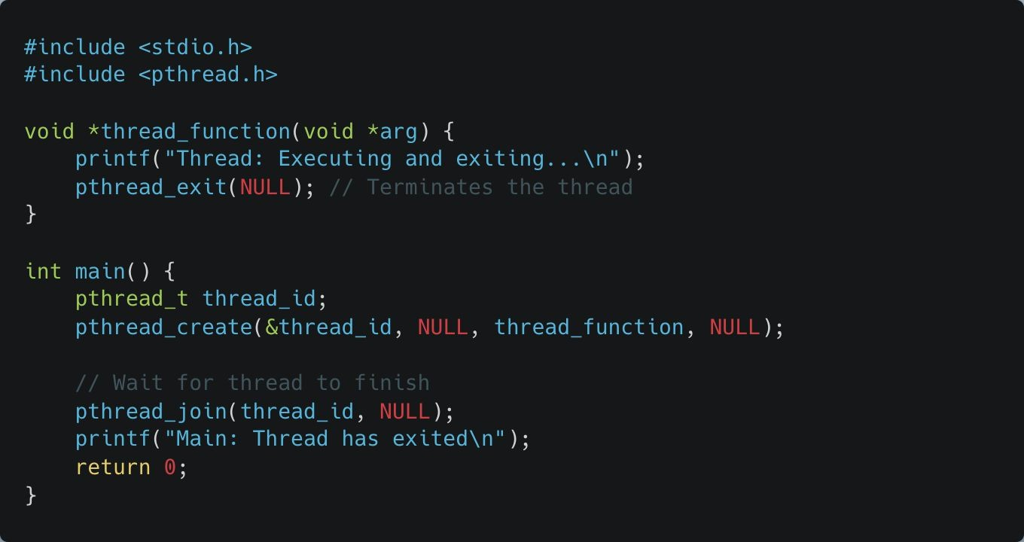
Multithreading in C
Terminating a Thread
The pthread_exit function terminates the calling thread, allowing it to optionally return a value to any thread waiting with pthread_join.
Notes:
Exiting Threads:
Illustrates using pthread_exit to finish a thread without returning a specific data pointer.
See example:
pthread_exit.c

Slide 26
Multithreading in C
Terminating a Thread
pthread_exit is used to exit the thread, and any cleanup handlers or resources are freed. Here, no value is passed back to the main thread.
The thread returns NULL, indicating it has finished executing without an output.
Key Concept: Each thread should generally call pthread_exit or allow the function to reach the end, as terminating a thread prematurely can lead to resource leaks.

Slide 27
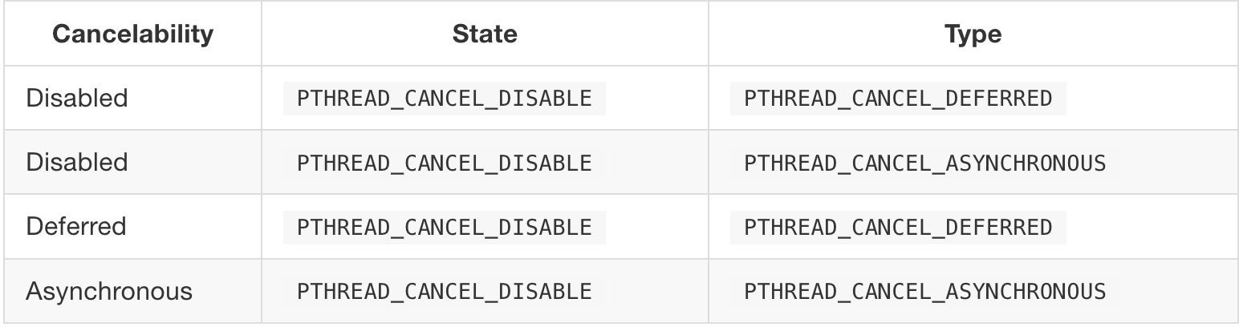
Multithreading in C
Stopping a Thread
pthread_cancel() requests cancelation of the target thread. The target thread
will be cancel according to its cancelability state. As shown in the table below:
PTHREAD_CANCEL_ENABLE
PTHREAD_CANCEL_ENABLE
Notes:
Stopping a Thread (pthread_cancel):
One thread can request the termination of another;
how the target responds depends on its "cancelability state.“
Cancelability States & Types:
Details PTHREAD_CANCEL_ENABLE/DISABLE and DEFERRED (at specific points) vs. ASYNCHRONOUS (immediate) cancellation.

Slide 28
Multithreading in C
Stopping a Thread
pthread_cancel() requests cancelation of the target thread. The target thread
will be cancel according to its cancelability state. As shown in the table below:
Cancelability State: Determines whether the thread can be cancelled or not.
PTHREAD_CANCEL_DISABLE: Cancelability is disabled, meaning the thread cannot be cancelled.
PTHREAD_CANCEL_ENABLE: Cancelability is enabled, meaning the thread can be cancelled.
PTHREAD_CANCEL_ENABLE
PTHREAD_CANCEL_ENABLE

Slide 29
Multithreading in C
Stopping a Thread
pthread_cancel() requests cancelation of the target thread. The target thread
will be cancel according to its cancelability state. As shown in the table below:
Cancelability Type: Specifies when the cancellation request takes effect if cancelability is enabled.
PTHREAD_CANCEL_DEFERRED: The thread checks for cancellation only at certain "cancellation points" (e.g., sleep, read, write calls). This is safer and allows for more controlled cancellation.
PTHREAD_CANCEL_ASYNCHRONOUS: The thread can be cancelled immediately, without waiting for a cancellation point. This can be risky since it may interrupt the thread at any time, possibly leaving resources in an inconsistent state.

Slide 30
Multithreading in C
Stopping a Thread
Cancelling this thread is disabled. Even if a cancel request is sent, it won’t take effect because cancelability is disabled.
pthread_cancel() requests cancelation of the target thread. The target thread
will be cancel according to its cancelability state. As shown in the table below:
PTHREAD_CANCEL_ENABLE
PTHREAD_CANCEL_ENABLE

Slide 31
Multithreading in C
Stopping a Thread
Cancelling this thread is disabled, so no cancellation will happen regardless of the type.
pthread_cancel() requests cancelation of the target thread. The target thread
will be cancel according to its cancelability state. As shown in the table below:
PTHREAD_CANCEL_ENABLE
PTHREAD_CANCEL_ENABLE

Slide 32
Multithreading in C
Stopping a Thread
The thread can be cancelled, but the cancellation will only happen at specific cancellation points (e.g., certain blocking calls).
pthread_cancel() requests cancelation of the target thread. The target thread
will be cancel according to its cancelability state. As shown in the table below:
PTHREAD_CANCEL_ENABLE
PTHREAD_CANCEL_ENABLE

Slide 33
Multithreading in C
Stopping a Thread
The thread can be cancelled immediately, allowing an immediate response to a cancellation request, but this approach can be unsafe as it might interrupt critical code execution.
pthread_cancel() requests cancelation of the target thread. The target thread
will be cancel according to its cancelability state. As shown in the table below:
PTHREAD_CANCEL_ENABLE
PTHREAD_CANCEL_ENABLE

Slide 34
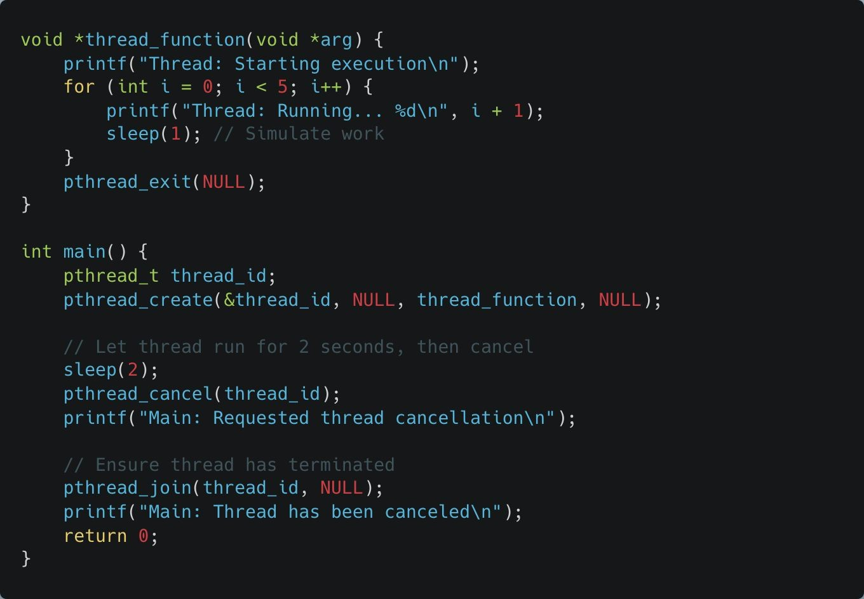
Multithreading in C
Stopping a Thread
The pthread_cancel function allows one thread to request cancellation of another thread, typically used for long-running or blocking operations.
Notes:
Cancellation:
Shows requesting a cancellation for long-running operations and emphasizes using cleanup handlers to avoid resource leaks.
See example:
pthread_cancel.c

Slide 35
Multithreading in C
Stopping a Thread
pthread_cancel sends a cancellation request, but the thread’s response depends on its cancellation state.
Key Concept: Threads should be designed to handle cancellations safely, particularly by using cleanup handlers to free resources or save state. You can set the thread to respond to cancellation immediately or only at defined "cancellation points" (like sleep, read, or write calls).

Slide 36
pthread_cancel vs pthread_exit
pthread_exit
Purpose: Used by the thread itself to terminate its own execution.
Usage: A thread calls pthread_exit when it wants to end, either with a return value (which other threads can retrieve via pthread_join) or without one.
Cleanup: Ensures that the thread terminates gracefully, releasing its resources and running any registered cleanup handlers.
Typical Scenario: A thread completes its task and calls pthread_exit to end normally.
pthread_cancel
Purpose: Used by a different thread to request the termination of another thread.
Usage: One thread calls pthread_cancel on another thread's ID to ask it to stop running.
Asynchronous or Deferred: The target thread can be set to respond immediately (PTHREAD_CANCEL_ASYNCHRONOUS) or wait until a “cancellation point” (PTHREAD_CANCEL_DEFERRED), allowing it to clean up before termination.
Typical Scenario: One thread needs to stop another thread because the task it was doing is no longer needed.
Notes:
pthread_cancel vs. pthread_exit:
Compares self-termination (exit) for normal task completion vs. external requests (cancel) when a task is no longer needed.

